Slide 1
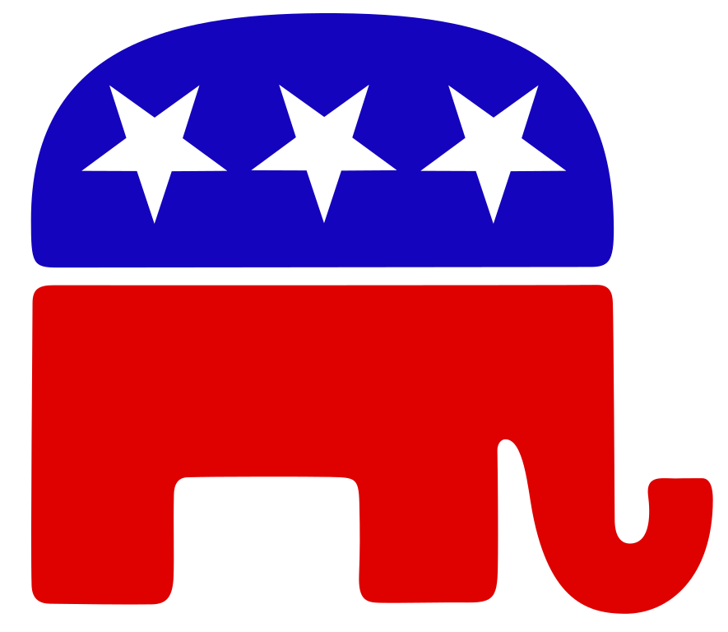

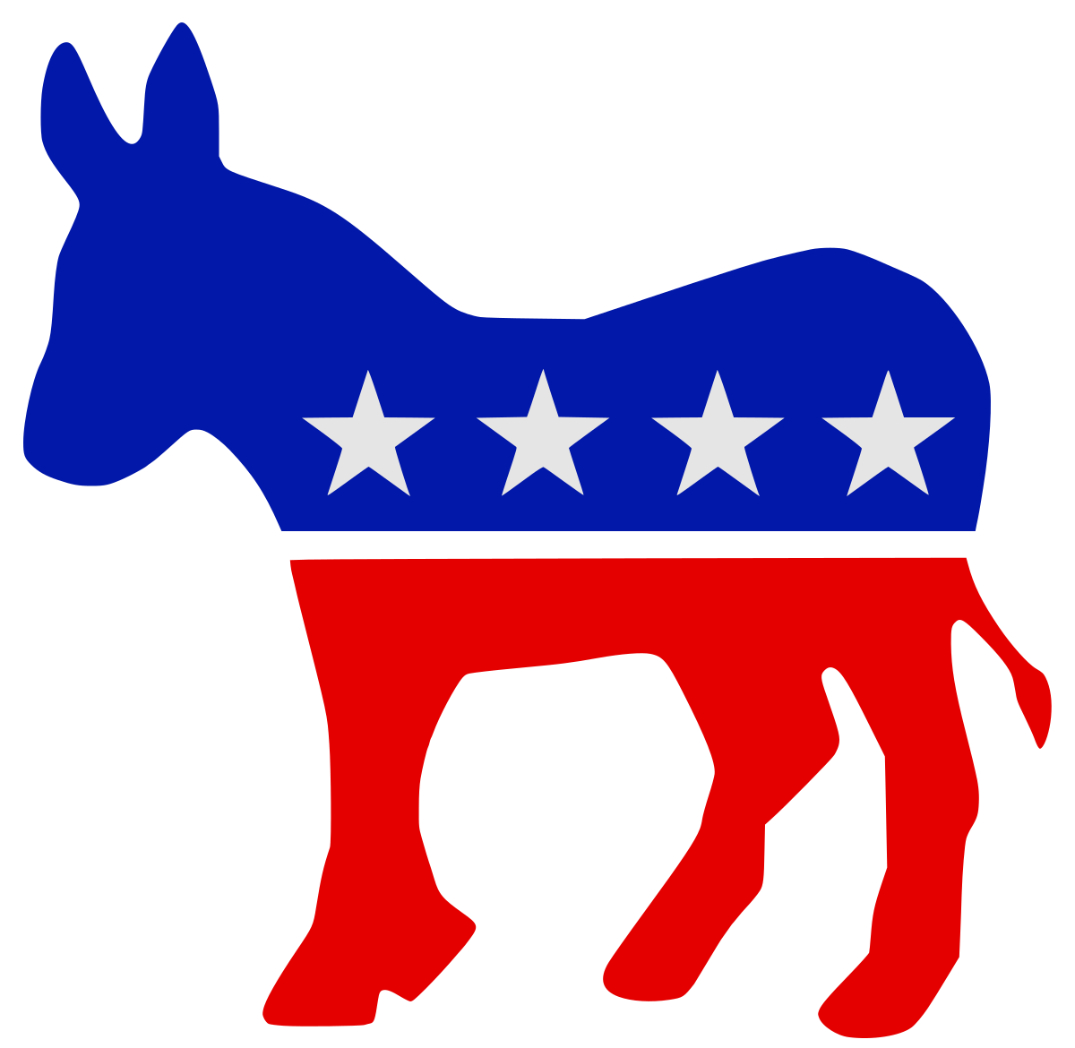
Predicting Political Party
by Covid
Search Trends
Data Analytics, UC Berkeley,
May 2022
- Aurora Christensen -

Slide 2
Project Overview

Slide 3

Background
Dec 2019
Novel Virus Detected
The first case of an unknown pneumonia virus is recorded in Wuhan, China.
Jan 2020
Virus is named. And traveling…
The first novel coronavirus case is recorded in Washington State, USA.
Mar 2020
… Everywhere
TLDR pandemic recap…
The WHO declares a global pandemic.
Dec 2020
A vaccine is approved
The FDA issues an Emergency Use Authorization for the first Covid19 vaccine. (CDC 2022)

Slide 4
The Question
Vaccination rates are clearly divided along political lines.
(NYT 2021)
Can a state's political party be predicted by covid vaccine search trends?
“Science has not yet mastered prophecy”
- Neil Armstrong
Other behavior may be correlated along political lines too.
Humans suffer from confirmation bias.
(Britannica 2019)
Notes:
Confirmation bias: a pattern of seeking out information that affirms current beliefs (Britannica 2019).

Slide 5
Technologies
Code
Python | Jupyter Notebook
(Pandas, SQLAlchemy,
SciKit, Psycopg2, Plotly)
Data
SQL
PGAdmin
“Technology alone is not enough”
- Steve Jobs
Viz
Tableau

Slide 6
Data

Slide 7
Data Sources
Google Trends: Covid-related search terms were collected from Nov 2019 to Apr 2022, weighed relative to each other, and filtered by state.
Cook Partisan Voting Index: PVI is a measurement of how much a state leans Republican or Democratic compared to the nation as a whole.
MIT Election Data + Science Lab: Historical presidential and senate election results were retrieved by state.
“No data is clean, but most is useful.”
- Dean Abbott

Slide 8
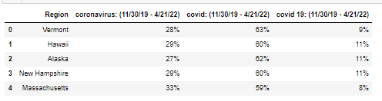
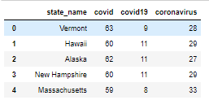
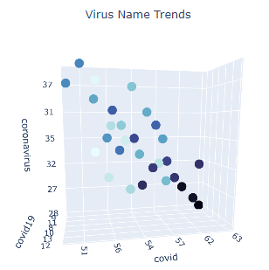
Data Exploration
Google search trend data required conversion from objects to integers prior to analysis.

Slide 9
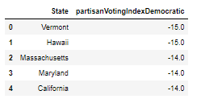
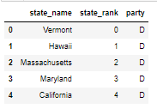
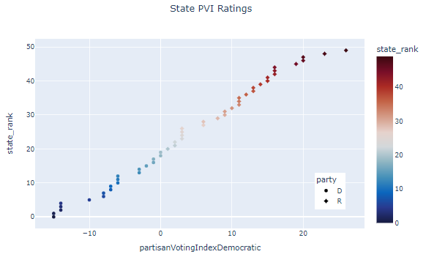
Data Exploration
PVI required transformation from an alphanumeric rank to numeric rank with binary classification of dominant political party.

Slide 10
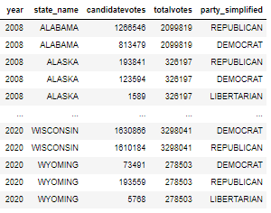
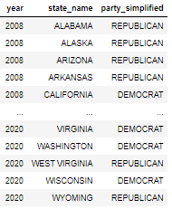
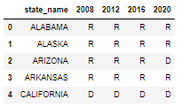
Data Exploration
Keep top candidate per year, state
Pivot
Presidential data required filtering for the most recent elections, keeping only the winning party for each year and state, and pivoting the data to desired output configuration.

Slide 11
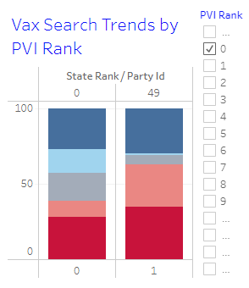
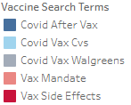
Data Exploration
An initial look at how the most Democratic state (Vermont) vs the most Republican state (Wyoming) searched for vaccine info.
Notes:
0 = Vermont, 1= Wyoming
Common: vax side effects,: covid after vax
Divergent: vax mandate
Shocking: where to get the vaccine!!
This gave me hope for my model….

Slide 12
SQL Database

Slide 13
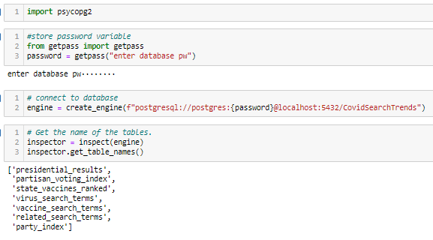

SQL Database
Confirm connection
Read in data for model
Data
Python
Database
Model
Raw data is read into Python…
Where it is transformed…
Then moved to the database…
And retrieved by the machine learning model.

Slide 14
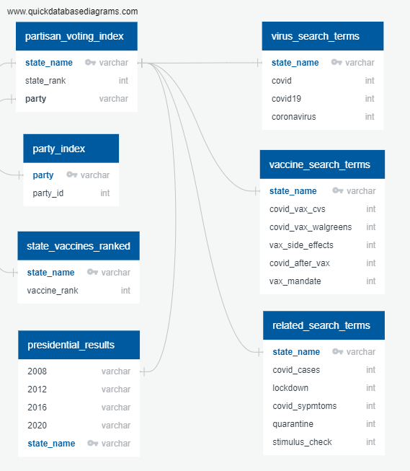
SQL Database
ERD made with
quickdatabasediagrams.com

Slide 15
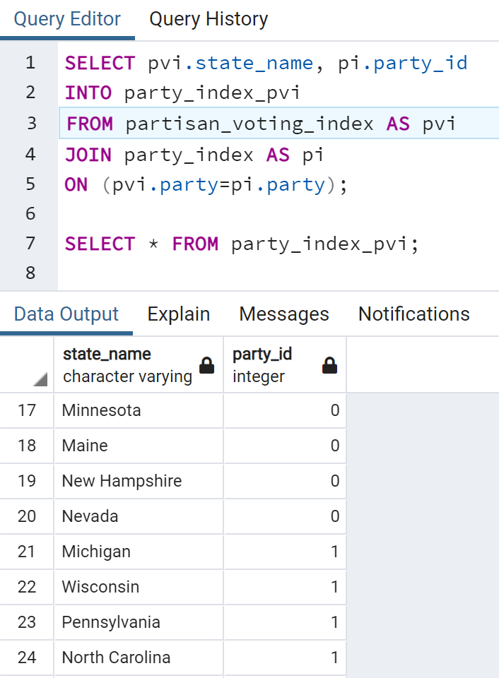
SQL Database
“Talk is cheap. Show me the code.”
- Linus Torvalds
Notes:
Linking the target (D or R) in numeric format to the state name for input into the model

Slide 16
Analysis + Visualizations

Slide 17
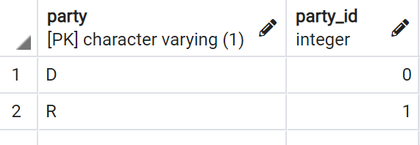
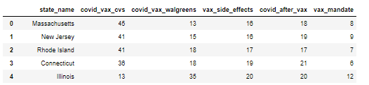
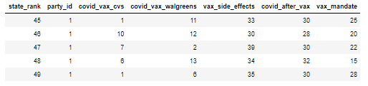
Data Prep
Data needed to be merged
into a single table
prior to analysis
by machine learning
or visualization in Tableau.

Slide 18
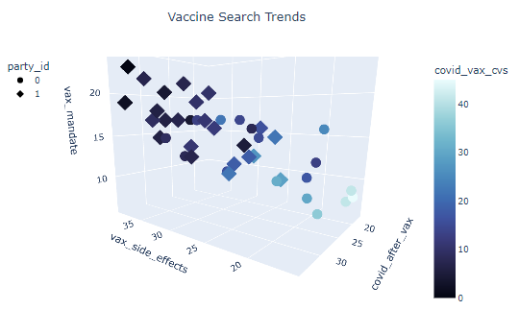
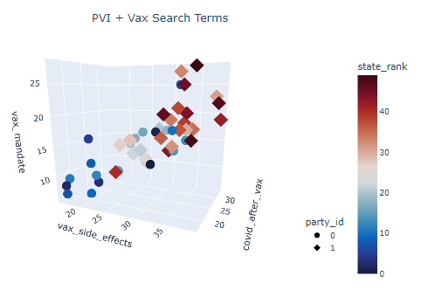
Data Analysis
“If we have data, let’s look at data. If all we have are opinions, let’s go with mine.” — Jim Barksdale
Notes:
Adding PVI rank creates a clear gradient, but is not a good feature choice because we are looking specifically at covid search trends and PVI is akin to the target.

Slide 19
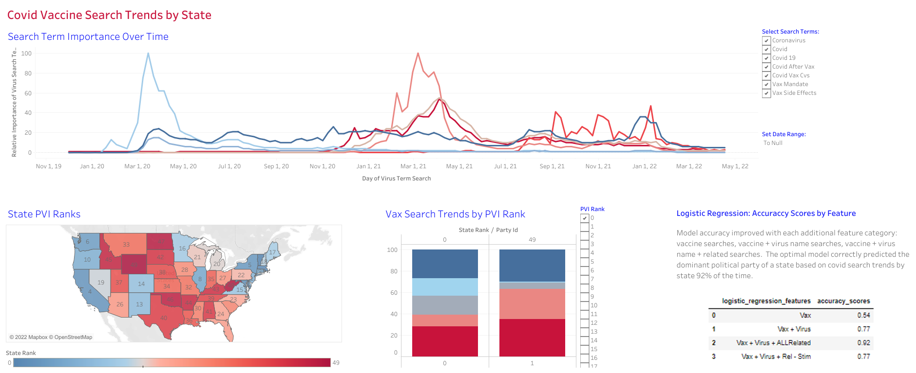
Tableau Interactive Dashboard
Notes:
Blue hue lines show what terms folks used to look up the virus: coronavirus, covid 19 and covid. Coronavirus was popular early and then covid became dominant.
Red hue lines show how folks look up the vaccine, with the first pink spike being where to get vaccinated, the second spike being split between the chances getting covid after being vaccinated and any side effects, and the third chain of spikes being the vax mandate.

Slide 20
Machine Learning

Slide 21
Logistic Regression
Why
Classifies outcomes into one of two classes: Democrat or Republican.
Pro
Handles multiple independent variables, ease of setup compared to neural networks.
“Without big data you are blind deaf and in the middle of the freeway”
- Geoffrey More
Con
Limited by the assumption that relationships in the data are linear.

Slide 22
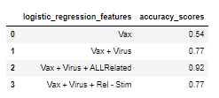
Feature Selection
What do folks call the virus?
Vaccine Searches
Related Searches
Coronavirus
Covid
Covid 19
Covid after vaccination
CVS covid vaccine
Walgreens covid vaccine
Vaccine side effects
Vaccine mandate
Covid cases
Lockdown
Covid symptoms
Quarantine
Stimulus Check
Covid “treatment strategies” (including vaccines) were the second most searched Covid topic after “symptoms”.
Other major categories were transmission, activity modification, and policy. (JMIR 2020)
All 3 feature categories were important to the training of the logistic regression model.
Notes:
The Journal of Medical Internet Research study came out at the end of 2020, and search trends have changed since then, but this was a helpful place to start.

Slide 23
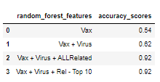
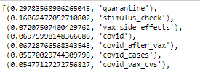
Algorithm Testing
Logistic Regression vs Random Forest
How do you add flavor to your algorithm?
Use a Boolean cube.
Top Features
Notes:
Top 3 features were quarantine, stimulus check, and vax side effects.
Bottom 3 were lockdown, covid symptoms, and coronavirus.

Slide 24

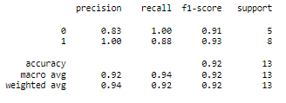
Model Evaluation
Logistic Regression Confusion Matrix
Logistic Regression Classification Report
“All models are wrong,
but some are useful.”
- George Box
Notes:
True pos, False Neg
False pos, True Neg
Precision, or positive predictive value, shows how likely is it that a categorization was correct.
Democratic states: 83% precision or 5 out of 6 predictions were correct.
Republican states: 100% precision, or 7 out of 7 predictions.
Secsitivity, or recall, shows how many were correctly categorized.
Democrat states: 100% recall, or 5 out of 5 democratic states were correctly categorzed.
Republican states: 88% recall, or 7 out of 8 republican states were labeled correcctly.
Overall accuracy was 92%

Slide 25
In Conclusion

Slide 26
Conclusions
Top Accuracy Score: 92%
Best Model: Logistic Regression has slight edge over Random Forest in accuracy across feature selection.
Limitations: Small sample size, there are only 50 states. The testing set was only 13 data points.
“Numbers have an important story to tell. They rely on you to give them a clear and convincing voice.”
- Stephen Few

Slide 27
Looking Forward
Additional Analysis
Breakdown by metro: the number of states, 50, limits the data. Taking a larger sample, metropolitan area (~300), would result in a better dataset for training and evaluation of any model.
Vaccine brands, and emerging treatment options: Vaccine distribution by brand could be impacted by geography. Different states may or may not have strong feelings about other treatment options, such as pill prescriptions. A look at the search trends around vaccine branding and emerging treatment options could impact model accuracy.
Statistical analysis: run each model a number of times and perform a 2 sample t-Test to determine if the accuracy scores of the logistic regression and random forest models differ from each other.
Personal Improvement
Don’t pull so much data up font. I collected data enough for 3 more categories of features that I didn’t use.
Think more about how a feature should or should not impact the model before I clean the data: state rate rank is an example of an inappropriate feature because it has nothing to do with google search trends and would overtrain the model. Same for presidential election results, this data is redundant to PVI.
“An investment in knowledge pays the best interest.”
- Benjamin Franklin

Slide 28
Citations
CDC 2022, CDC COVID-19 Timeline, accessed 2022-4-21, cdc.gov/museum/timeline/covid19
The New York Times 2021-09-27, Red Covid, accessed 2022-04-21, nytimes.com/2021/09/27/briefing/covid-red-states-vaccinations
Britannica 2019, Confirmation Bias, accessed 2022-04-21, britannica.com/science/confirmation-bias
Harvard Dataverse 2020, U.S. President 1976–2020, MIT Election Data and Science Lab, accessed 2022-04-21, electionlab.mit.edu/data
Google Trends 2022, accessed 2022-04-21, trends.google.com/trends
Journal of Medical Internet Research 2020-11, Covid-19-Related Internet Search Patterns Among People in the United States, accessed 2022-04-21, https://www.ncbi.nlm.nih.gov/pmc/articles/PMC7685696/
Credit where credit is due…

